Slide 1
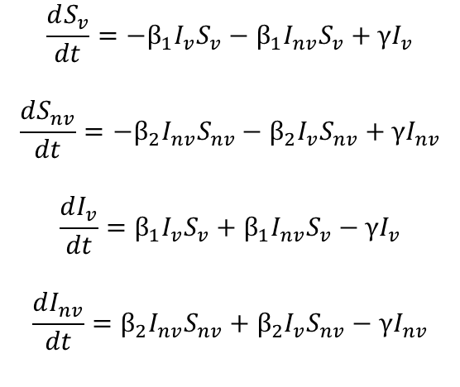
γI_{v}
Model Equations
$$\frac{dS_{v}}{dt}=−β_{1}I_{v}S_{v}−β_{1}I_{nv}S_{v}+γI_{v}$$
$$\frac{dS_{nv}}{dt}=−β_{2}I_{nv}S_{nv}−β_{2}I_{v}S_{nv}+γI_{nv}$$
$$\frac{dI_{v}}{dt}=β_{1}I_{v}S_{v}+β_{1}I_{nv}S_{v}−γI_{v}$$
$$\frac{dI_{nv}}{dt}=β_{2}I_{nv}S_{nv}+β_{2}I_{v}S_{nv}−γI_{nv}$$
“Shielded”
Population
S_{v}
β₁I_{v}S_{v}
I_{v}
β₁I_{nv}S_{v}
β₂I_{v}S_{nv}
“non-Shielded”
Population
S_{nv}
I_{nv}
β₂I_{nv}S_{nv}
γI_{nv}
Phase | Weeks | Beta1 | Beta2
0 | Up to I(t) = 0.0182 | 0.161 | 0.161
1 | 0-6 | 0.064 | 0.064
2 | 6-30 | 0.064/0.032/0 | 0.161
3 | 30 onwards | 0.161 | 0.161
4 | If phase 3 ends | 0.258 | 0.258
Phase | Weeks | Beta1 | Beta2
0 | Up to I(t) = 0.0182 | 0.161 | 0.161
1 | 0-6 | 0.097 | 0.097
2 | 6-30 | 0.097/0.049/0 | 0.161
3 | 30 onwards | 0.161 | 0.161
4 | If phase 3 ends | 0.258 | 0.258
BASELINE
RWC
Initial Conditions
Sv | Snv | Iv | Inv
0.2 | 0.7999 | 0 | 0.0001
Equivalent to R0 = 2.4 -> 1.5 -> 0.6/0.3/0 -> 2.4

Slide 2
SIS Model
Explore the SIS model and the effect of indefinite length interventions – explore how we can prevent the SIS model taking off.

Slide 3
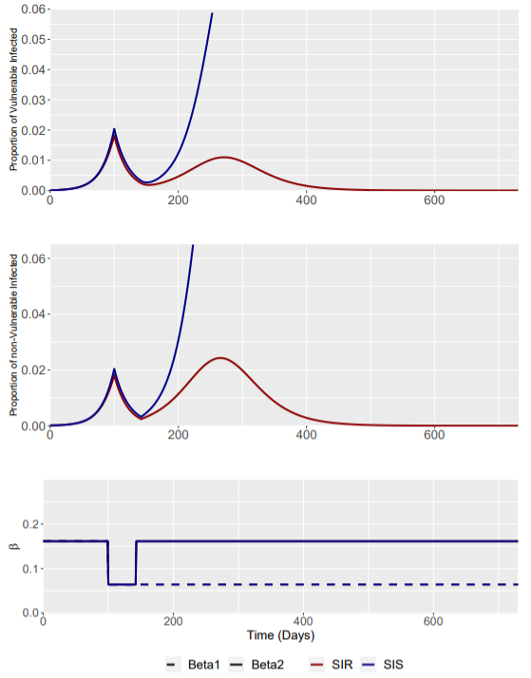
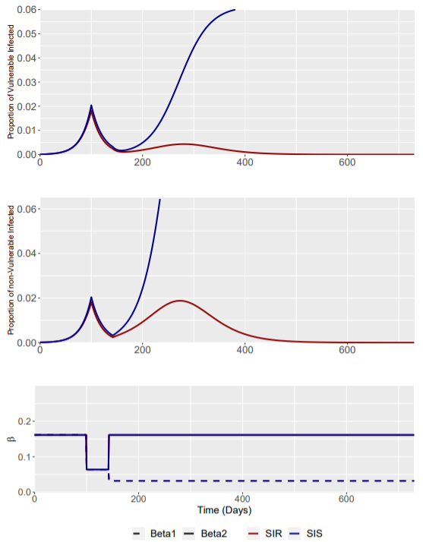
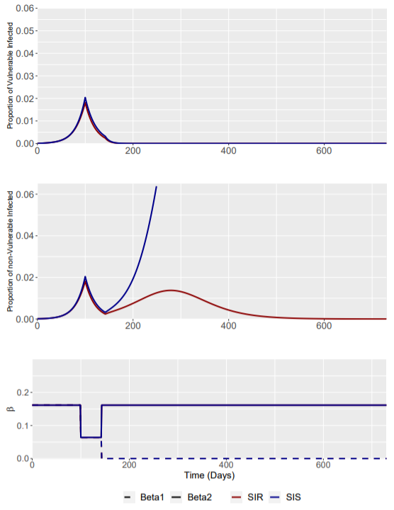
Interventions were assumed to last indefinitely to beta1 (the shielded population).
Only beta1 reductions to 0 were able to prevent Iv(t) increasing above 0.0182 – However, sustaining an intervention of this magnitude indefinitely is extremely difficult.
Phase 2 (Beta1 = 0.064)
Phase 2 (Beta1 = 0.032)
Phase 2 (Beta1 = 0)

